Slide 1

GPFV
New Contractual Models and Working at Scale
Katrina Cleary
Programme Director Primary Care
Sheffield CCG
&
Andy Hilton
GP and CEO
Primary Care Sheffield

Slide 2
Local Perspective
Where we are currently
How you have engaged with us
How we might move forward together
Potential impact of the wider system change on General Practice

Slide 3

Primary Care In Our City

Slide 4
Sheffield in a strong position:
High quality General Practice
Established locality structures
City wide Primary Care provider with every practice as shareholder
Emerging Neighbourhood working
Wider system recognises importance of Primary Care and General Practice as key stakeholders.
Commitment from LMC, PCS and CCG to work together wherever possible for the benefit of our shared membership.

Slide 5
City
X 1 (Subcontracts?)
Locality 100-150,000
X 4
Neighbourhood 30-50,000
X 16
Practice
X 82

Slide 6

62 nurses and Health Care Assistants attended vaccination & immunisation updates (with more on the way!)
GP FORWARD VIEW WORK PROGRAMMES
What are we talking about?
40 places have been offered for Spirometry training (both performance and interpretation)
Every practice in Sheffield offered HR and Health & Safety advice packages
10 practices completed the GP Improvement Programme
17 members of staff from 12 practices on Fundamentals of Change and Improvement
18 people from 12 practices attended a workshop on improving access
9 practices received an access diagnostic tool and training to use this tool
43 practices completed the Productive General Practice Programme
Clinical Coding:
14 practices on Level 1
9 practices on Level 2
37 practices on Level 3
7 practices received
NHS England support package
60 members of staff from 36 practices on Institute of Leadership and Management courses
11 practices attended a workshop on federations and mergers
Bespoke
Quality Improvement programme for change leaders

Slide 7
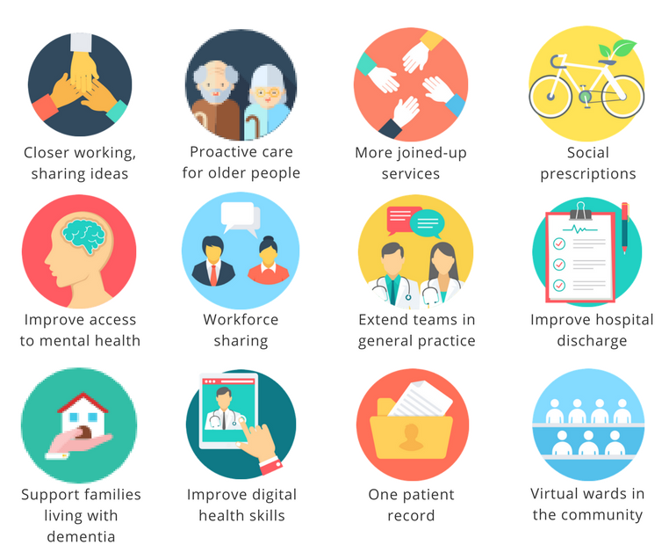
What’s happening in Neighbourhoods right now?
Notes:
What’s happening in Neighbourhoods right now?
Projects underway
These appear in your ‘Neighbourhoods in a Nutshell’ guide but I’ll quickly summarise what these projects are about:
Closer working – practices attend regular Neighbourhood meetings together now to share ideas & knowledge, planning.
Proactive care for older people – better case management planning for older people e.g. Crystal Peaks.
More joined up services – for example Upper Don Valley NH working with their local Community Forum.
Social prescriptions – citywide approach utilising community support workers, People Keeping Well work.
Improve access to mental health – Sheffield (Sheffield Health & Social Care NHS FT) has recently been awarded over £2m to join up IAPT services with 10 condition pathways such as MSK, pain, LTC etc. They’re working with NH now to develop these both at local and citywide level. These will help NHs with specific MH needs and improve identification of anxiety and depression.
Workforce sharing – As it sounds. E.g. One NH is using WhatsApp as a way to manage rotas and fill in gaps if a staff member calls in sick.
Extending teams – e.g. Peak Edge NH pilot using paramedics to manage housebound/urgents to avoid hospital admission.
Hospital discharge – lots to come on this DTOC.
Support families living with dementia – setting up cafes, drop-ins for family members etc with local VCS.
Digital health skills – Sheffield has been chosen as a pilot to trial improving digital literacy. If anyone is interested in this area, please see Kara before you leave as we have some opportunities to get involved in this just around the corner.
One patient record – this is on its way.
Virtual wards – successful pilot in GPA1 NH – now being tested across 4 NHs in Central locality with hope we can spread citywide later in year. Runs like a hospital ward (paint a picture for them) just virtually to provide intensive, short term support for people at risk or returning from hospital admission i.e. older, LTC people.
If you’d like further details on any of these, get in touch via sheffield.neighbourhoods@nhs.net.
Lots of stuff still to come and that’s why it’s great that PPGs are involved from here on out.
Are any of you involved already? Quick anecdotal feedback about Darnall, Upper Don Valley, Woodhouse (Townships 1)
NHs appear to have started including PPG members in some areas but tell us your experience.

Slide 8

What’s On the Horizon?

Slide 9
In Support of At Scale Working
Build on what you’re already doing
Focus on function not form
Understand and engage with the change
  Developing strategies (National & Local)
  Continued GPFV
  Urgent care in primary care
Neighbourhood Maturity Self Assessment
Primary Care Networks
MCP Contractual Framework: CCG,LMC and PCS - workshops to develop thinking
Increased Collaborative Working

